Slide 1

Attack (SI|E)mulation

Slide 2

#whoami
👉 Chirag Savla
👉 Twitter – @chiragsavla94
👉 Interest area – Red Teaming, Application Security, Penetration Testing
Blog – https://3xpl01tc0d3r.blogspot.com

Slide 3
Prevention is ideal, detection is a must

Slide 4
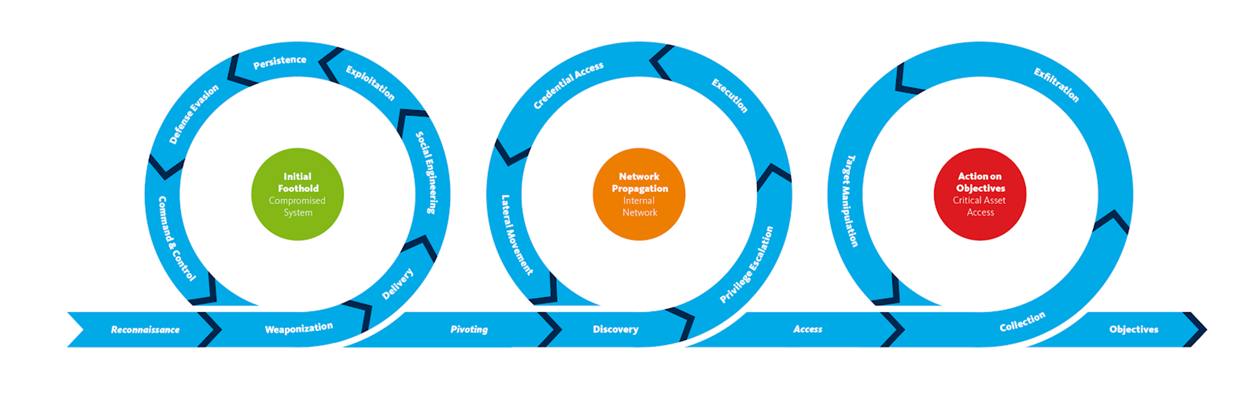
Attack Kill Chain

Slide 5
Threat Hunting
Problem: I need a threat to hunt for!
Solution: Create one by emulating real adversaries.
Advanced attack simulation and emulation should be based on realistic TTPs, for which MITRE is (becoming) the de facto framework.

Slide 6
Difference between Simulation & Emulation ?
Simulation -
To produce something that is not real but has the appearance of being real.
Based on the Red Team’s experience
Based on environment at hand
Based on global technique popularity
Emulation -
To behave in the same way as someone else.
Based on threat intelligence
TTPs of adversaries that will target you
Based on a previous simulation
Simulate an adversary that is not real
Impersonate APT-28

Slide 7
What is MITRE ATT&CK ?
MITRE ATT&CK is a globally-accessible knowledge base of adversary tactics and techniques based on real-world observations.
The ATT&CK knowledge base is used as a foundation for the development of specific threat models and methodologies in the private sector, in government, and in the cybersecurity product and service community.

Slide 8
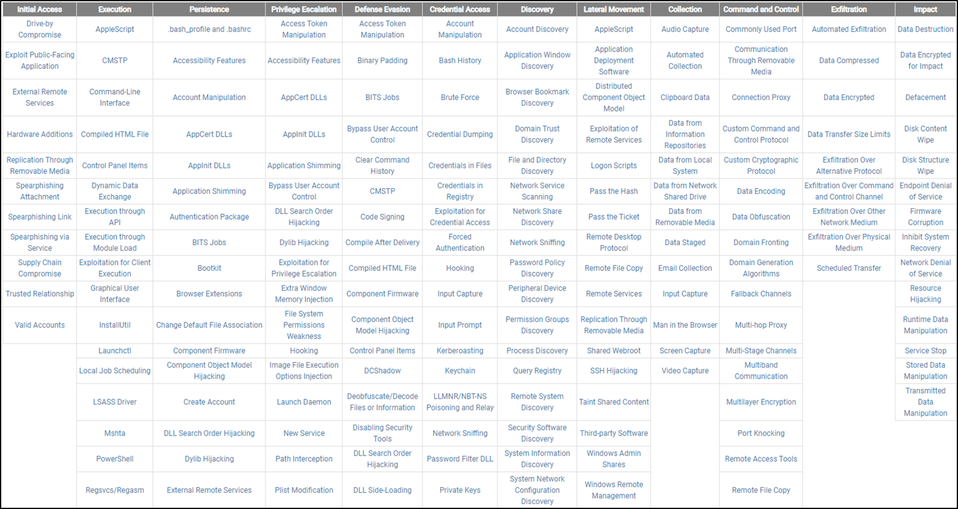
What is MITRE ATT&CK ?

Slide 9
What is TTP ?
Tactics –
Tactics represent the “why” of an ATT&CK technique. Tactics represent the tactical goals of an adversary
Techniques –
Techniques represents “how” an adversary achieves a tactical objective by performing an action.
Procedures -
Procedures are specific detailed instructions and/or directions for accomplishing a task.

Slide 10
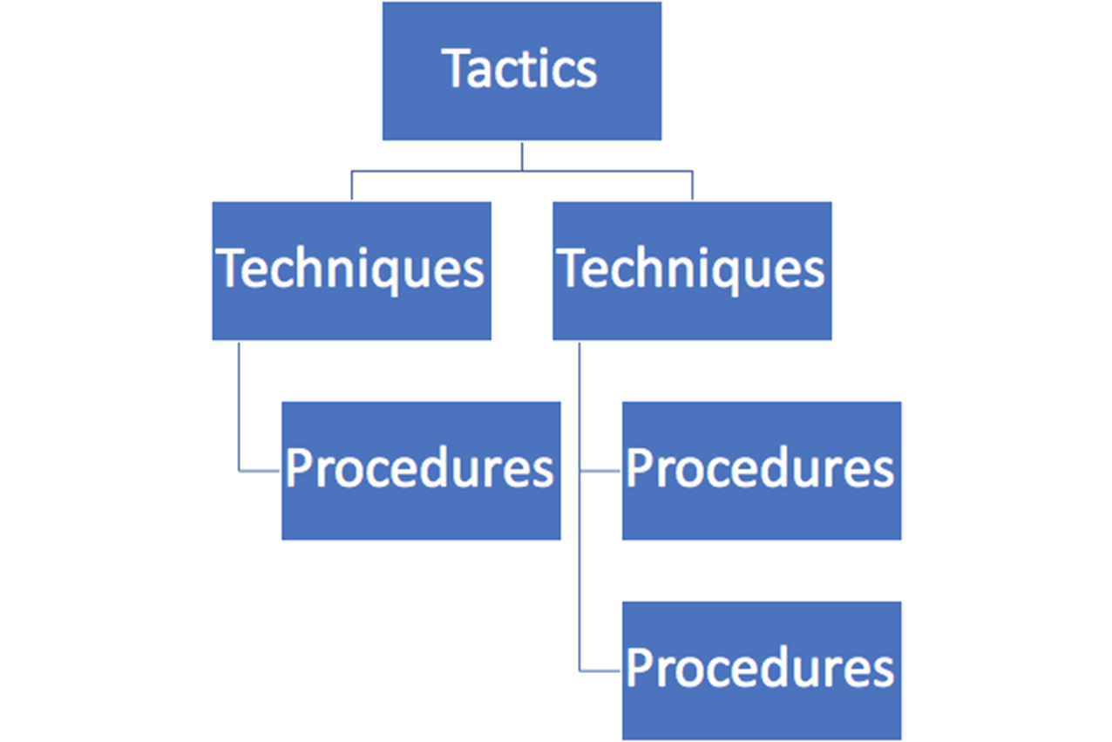
What is TTP ?

Slide 11
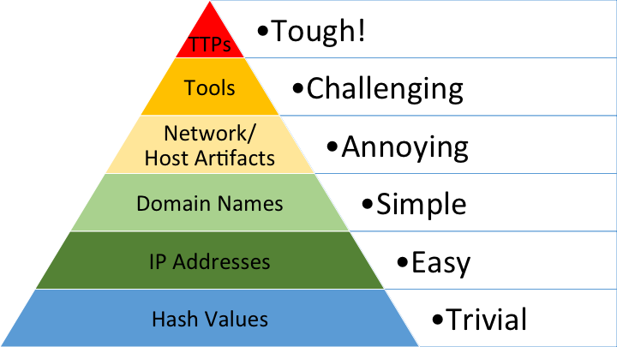
Why TTP ?

Slide 12
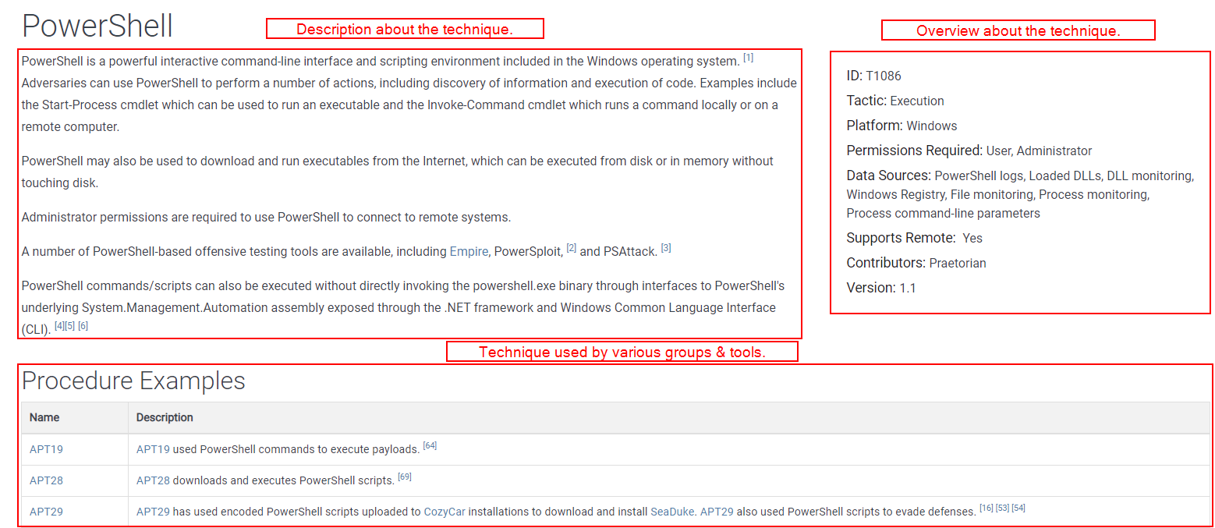
Detail about the technique

Slide 13
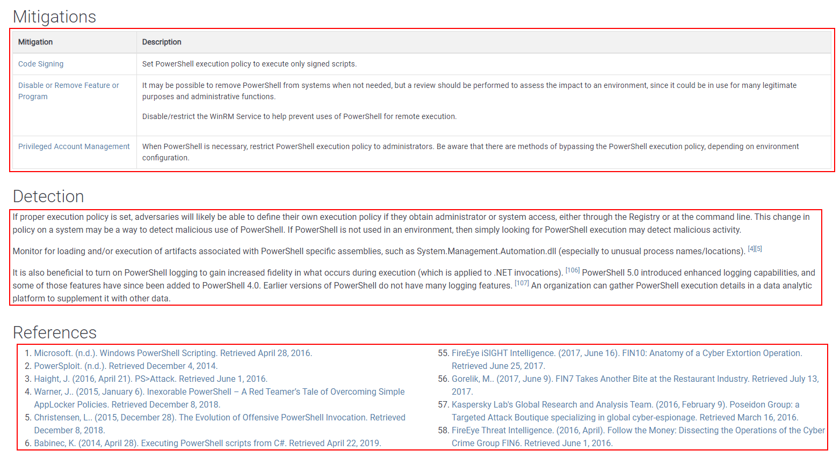
Detail about the technique

Slide 14
Leveraging MITRE ATT&CK
ATT&CK for Adversary Emulation
When organizing adversary emulation (such as red or purple team exercises), the emulation plan can be based on MITRE ATT&CK. This facilitates tracking & reporting.
ATT&CK for Threat Intelligence
When consuming or generating Threat Intelligence, observed adversary behavior can be mapped to MITRE ATT&CK. Several platforms support this mapping (e.g. MISP has a MITRE ATT&CK mapping).
ATT&CK for Detection Capability
The overall detection capability of an organization can be mapped to MITRE ATT&CK. This facilitates for example reporting on the maturity / scope of the SOC.
ATT&CK for Defense Prioritization
In addition to measuring the detection coverage using MITRE ATT&CK, we can do the same for preventive controls. What MITRE ATT&CK techniques do we actively block?

Slide 15
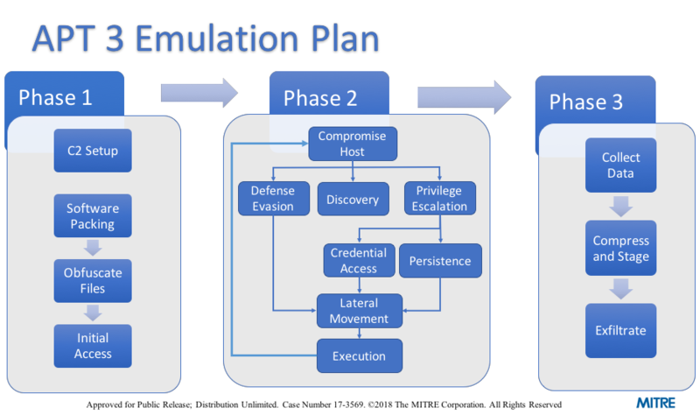
Prepare Emulation Plan

Slide 16
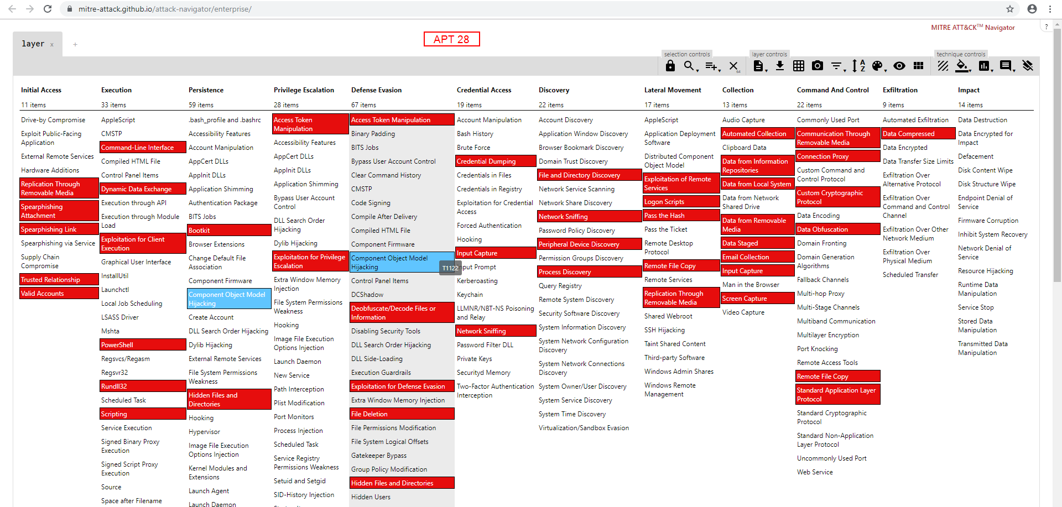
Prepare Emulation Plan

Slide 17
Prepare Emulation Plan
Select threat actors which are relevant to the organization
Select techniques used by the threat actors to emulate
Setup the infrastructure
List techniques which the security solutions can detect / prevent out of the box
Customize the tools for emulation
Define timelines for executing the plan
Define outcomes of the plans

Slide 18
Outcomes of the plans
Assessing controls effectiveness
Training and preparing the security team
Situational and risk awareness
Supporting security roadmap, technology purchasing and investment decisions

Slide 19









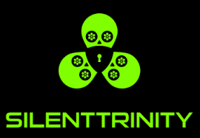


Arsenal
Automated / scripted emulation
Manual, full-stack, emulation

Slide 20
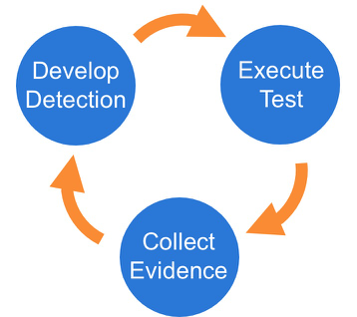
Improve Detection

Slide 21
Improve Detection
Select a technique
Execute the technique
Collect the logs
Develop the detection rule
Repeat the above steps
Create custom tools / script for executing the technique

Slide 22
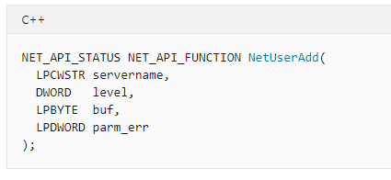
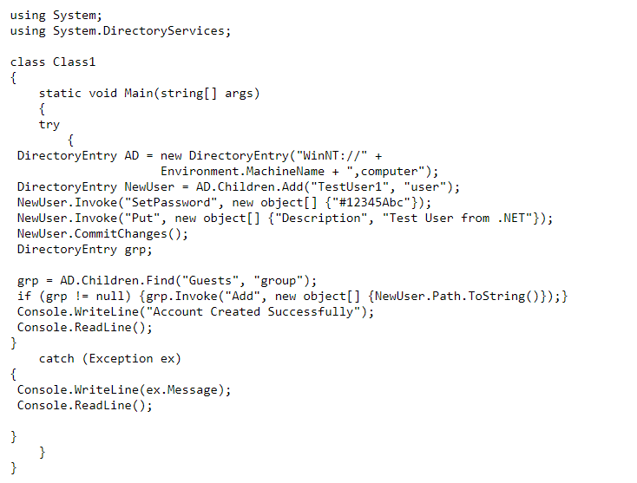
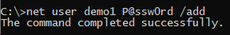
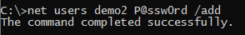
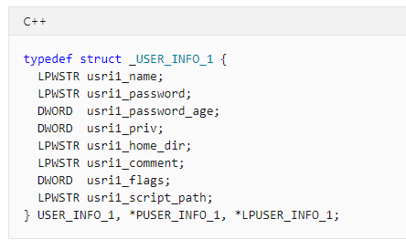
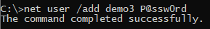
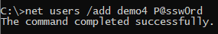
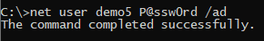
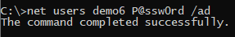
T1136 Create Account (Manual Approach)

Slide 23
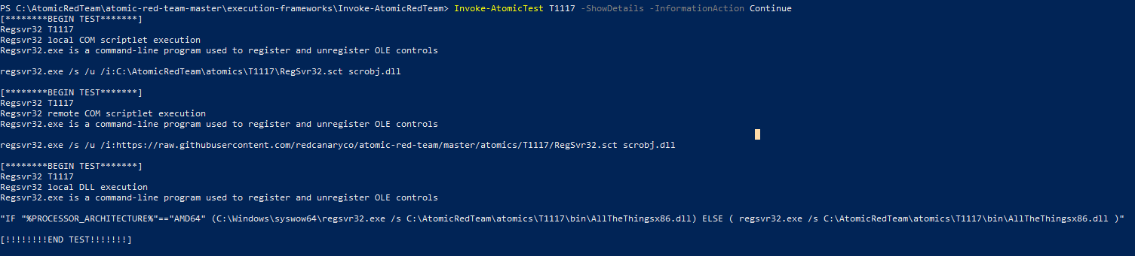
Atomic Red Team
Install Atomic Red
Technique Execution Details

Slide 24
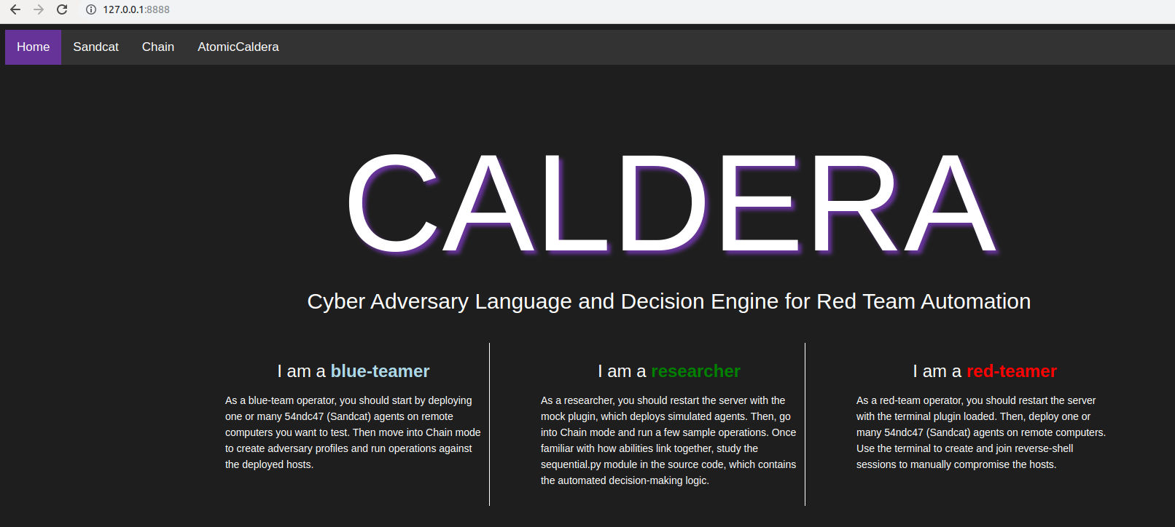
Caldera

Slide 25
Demo

Slide 26
Note
“Adversary Emulation” is not the final destination. There are different flavors that can be valid options, depending on your goals and environment

Slide 27
Credits
Thanks to @NullMumbai for granting me the privilege to present.

Slide 28
Reference
https://attack.mitre.org/
https://www.sans.org/cyber-security-summit/archives/file/summit-archive-1563791194.pdf
https://github.com/mitre/caldera
https://github.com/xenoscr/atomiccaldera
https://github.com/redcanaryco/atomic-red-team
https://www.cobaltstrike.com/
https://github.com/byt3bl33d3r/SILENTTRINITY
https://github.com/cobbr/Covenant
https://github.com/EmpireProject/Empire
https://www.guardicore.com/infectionmonkey/
https://github.com/FSecureLABS/C3
https://www.factionc2.com/
https://www.metasploit.com/
https://github.com/endgameinc/RTA
https://eqllib.readthedocs.io/en/latest/
https://uncoder.io/
https://github.com/Cyb3rWard0g/HELK
https://github.com/hunters-forge

Slide 29
THANKS!
Any questions?
You can find me at @chiragsavla94

